Slide 1
Credit Card Customer Expenditure Analysis
Overview : The analysis aimed to understand credit card customer expenditure to
identify high-value customers and their spending patterns. Data from
Kaggle and RBI was cleaned and analyzed using SQL, Excel, Tableau, and R
to identify key trends and correlations.
Goal : To find category of credit card users who spend the most and to develop
ideas to market our products to them
Presented by : Srivarshan AM
Date : 20/07/2024

Slide 2
Table of contents:
Title Slide
Heatmap by Region
Symbol Maps – State Wise
Bubble Chart – Female Spending
Column Chart – Average Amount Spent by Age Range
Column Chart – Monthly Spending Habits
Male vs. Female Spending Analysis
Summary of Key Insights
Conclusion

Slide 3
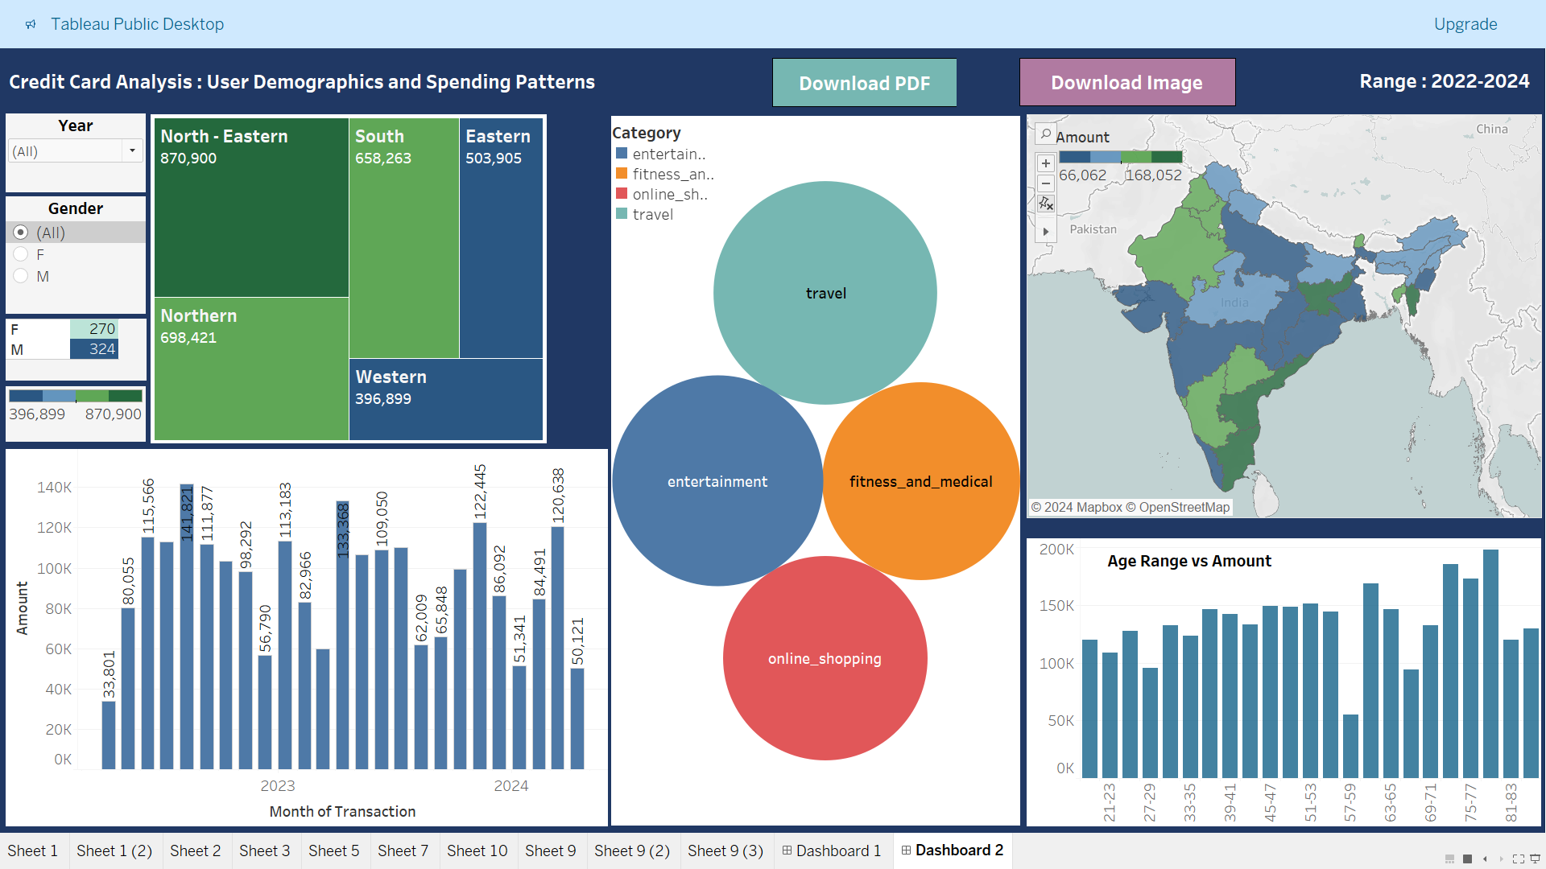
HEATMAP BY REGION
Insights:
Customers from northeastern states spend the most using credit cards
Southern and northern states follow in spending
The western region shows more caution in credit card spending

Slide 4
SYMBOL MAPS – STATE WISE
Insights:
Southern states, excluding Kerala, spend large sums via credit cards
Two northern states contribute significantly to the northeast's spending
The central region of India contributes less to total transactions and revenue

Slide 5
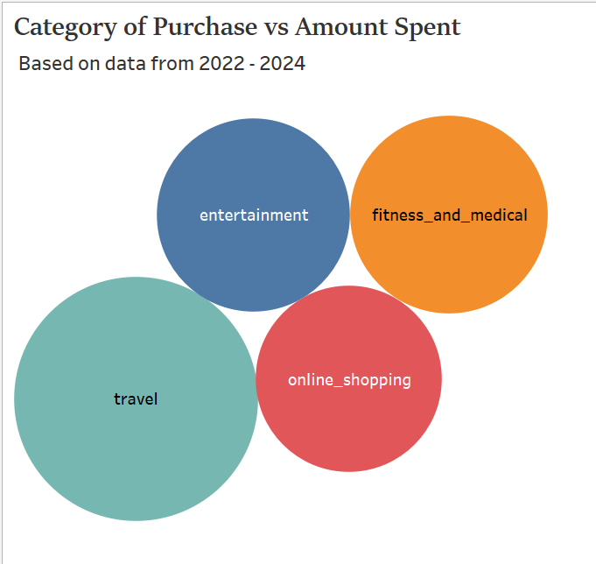
BUBBLE CHART – FEMALE SPENDING
Insights:
Female users spend more on travel and fitness
Younger users prioritize online shopping and fitness, while those over 40 focus less on online shopping

Slide 6
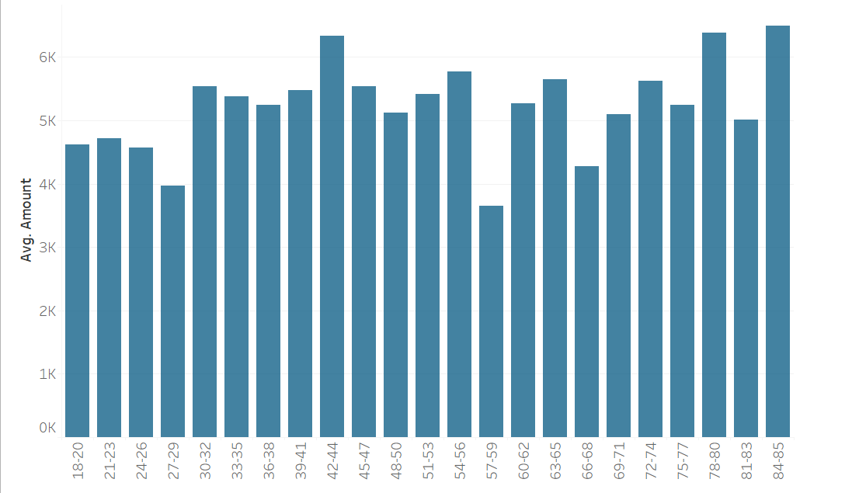
AVERAGE AMOUNT SPENT BY AGE RANGE
Insights:
Users aged 18-28 spend less compared to other age groups
Those in their late 50s and 60s spend conservatively
Elderly users in their 70s and 80s are the highest spenders

Slide 7
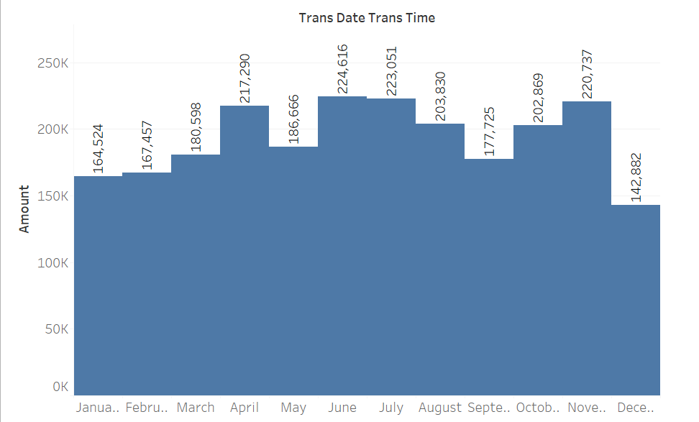
MONTHLY SPENDING HABITS
Insights:
June, July, and November see the highest spending
December to March shows a decline in spending

Slide 8
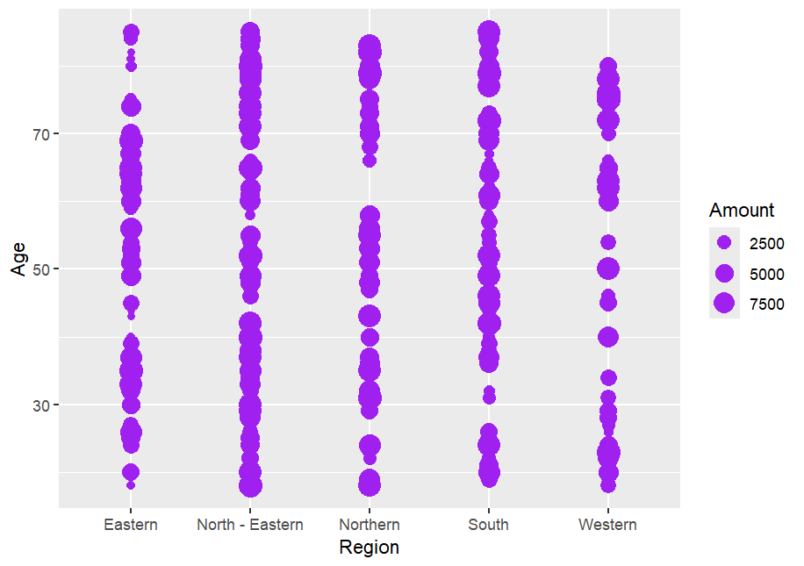
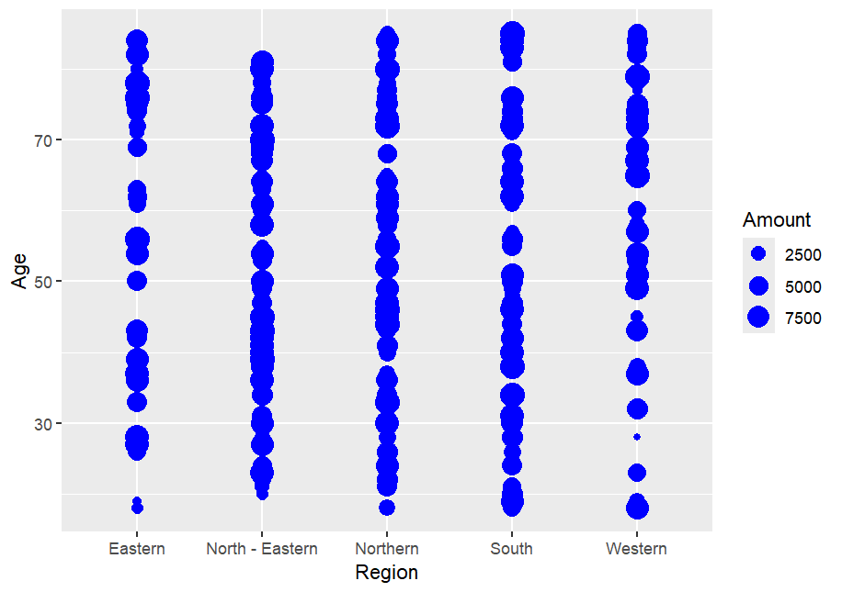
MALE VS FEMALE SPENDING ANALYSIS
Insights:
Younger females in the western region spend less
Males aged 35-60 in the western region spend minimally
Both genders in the northeast spend the most
Northern females outspend northern
males
Eastern males spend less than females across all age ranges
Male
Female

Slide 9
CONCLUSION
Potential Customers:
Users from North-eastern and Southern states of India
Female users – Fitness and medical
Younger users – Online shopping and Fitness
Elderly users between 70s and 80s
Female users from northern and eastern states
Recommendations:
Develop personalized offers for top spenders in northeastern states
Launch campaigns and offers during peak spending months (June, July, and November)
Create fitness and travel promotions targeting female customers
Tailor products and services with high cashbacks for elderly customers

